Slide 1

Ergonomics Semester 2 Week 11

Slide 2
What had been discussed last week
Find dataset with Vicon's output and try in OpenSim and our method

Slide 3
Timeline
Content | Date | Progress
Learning Basics of Deep Learning | Sep 2022 | Done
Installing VideoPose3D | Sep-Oct 2022 | Done
Learning Ergonomics Basics | Oct-Nov 2022 | Done
Forming a Framework of Time Continuous Cumulative Fatigue
Preparing for Final Exam | Nov-Dec 2022 | Done
Review the Time Continuous Cumulative Fatigue Framework | Dec 2022 | Done
Trying to Extract Coordinates Using Alphapose/Openpose | Dec 2022
Adding on a Cumulative Fatigue Assessment using VideoPose3D with Python | Jan-Mar 2023
Writing a Technical Report for our Research | Mar 2023

Slide 4
Challenges of Applying OpenSim
IKresults.mot
Inverse Dynamics
.trc
External forces
(Our Goal)
.c3d file
grd.mot
Vicon’s output
Video
Our algorithm

Slide 5




















Revision of Our Framework
Linear Kinematics Quantities
Upper Torso
2
y’’
0
1
2
3
x’’
y’’’
B
dt =
1
y’’’’
3
Angular Kinematics Quantities
fps
y’
4
x’’’
C
D
x’’’’
(Magnitude)
x’
A
(Direction)
y
1
x
O

Slide 6






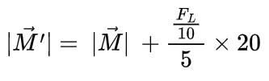



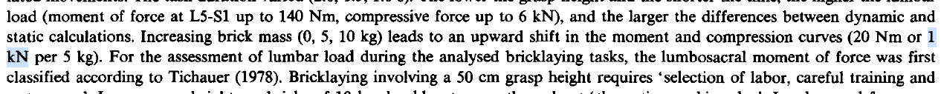
Revision of Our Framework
Axial Force (assume load = 5kg)
Bending Moment (assume load = 5kg)

Slide 7







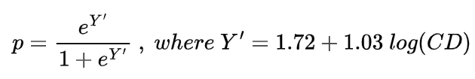
Revision of Our Framework
Total Lumbar Compressive Force (assume a = 5)
Probability of Injury Risk

Slide 8
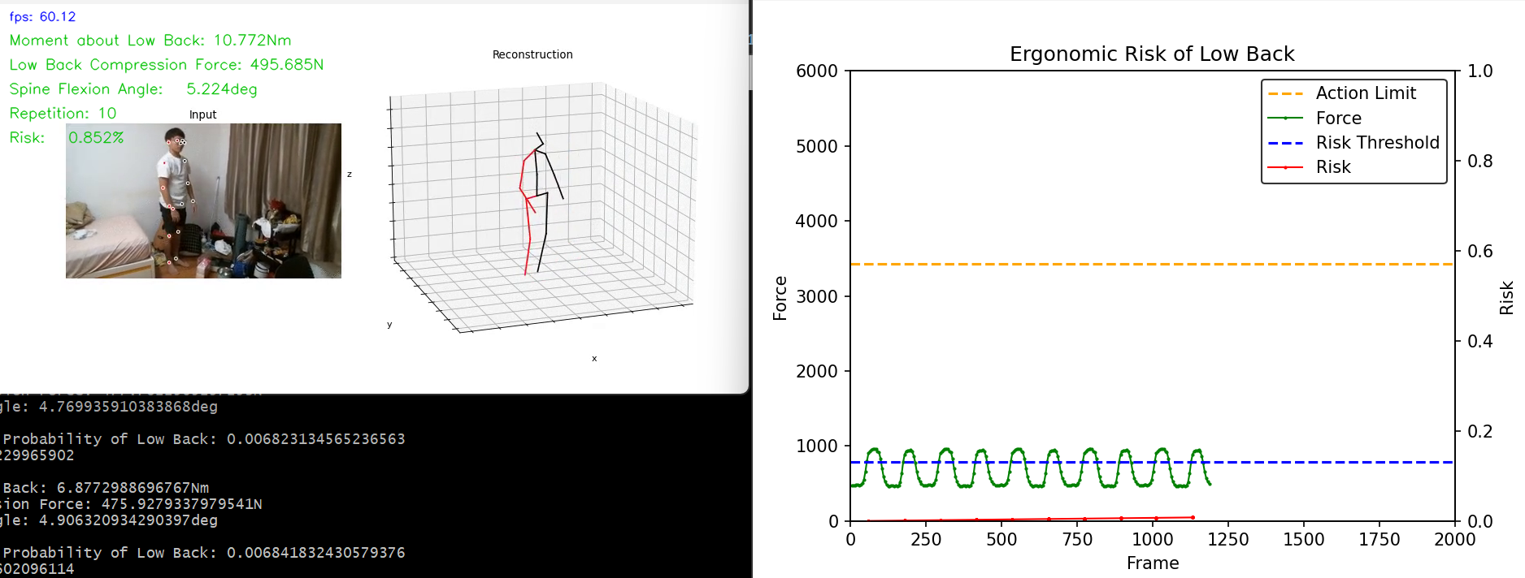
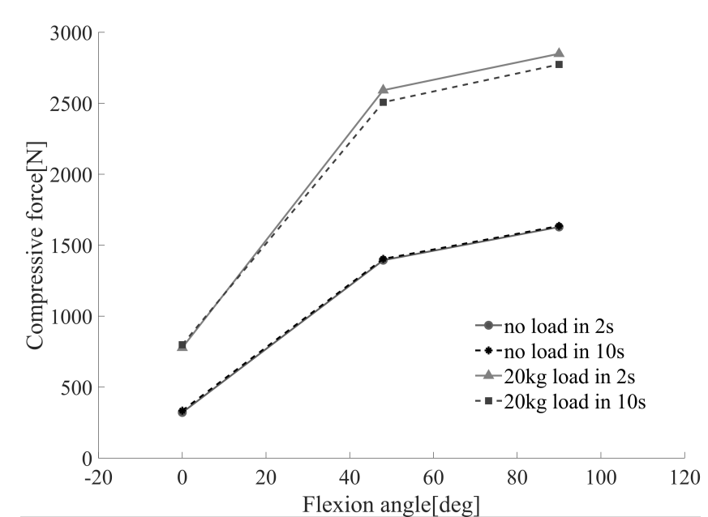
Body Weight: 600 N
Load: 0 N
a: 5
(Calibration to estimate a)
Validation of Lumbar Compressive Force Simulation in Forward Flexion Condition

Slide 9
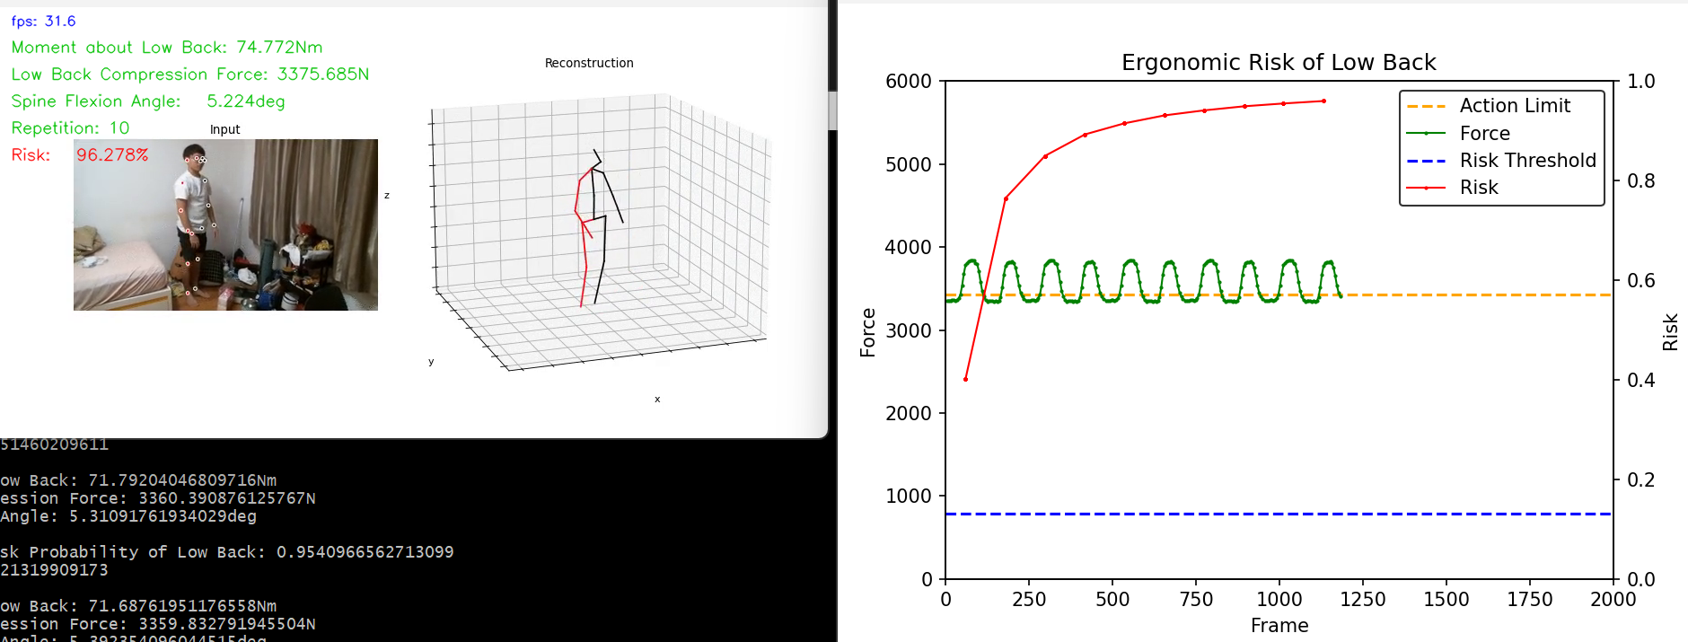
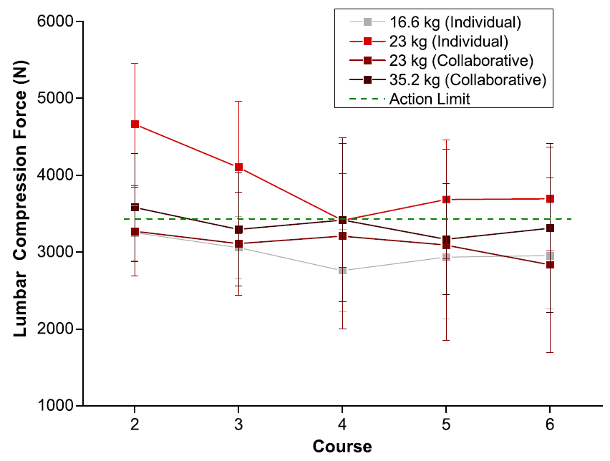
Body Weight: 600 N
Load: 160 N
a: 5
(Ryu et al. 2023) Ergonomic characteristics of expert masons

Slide 10
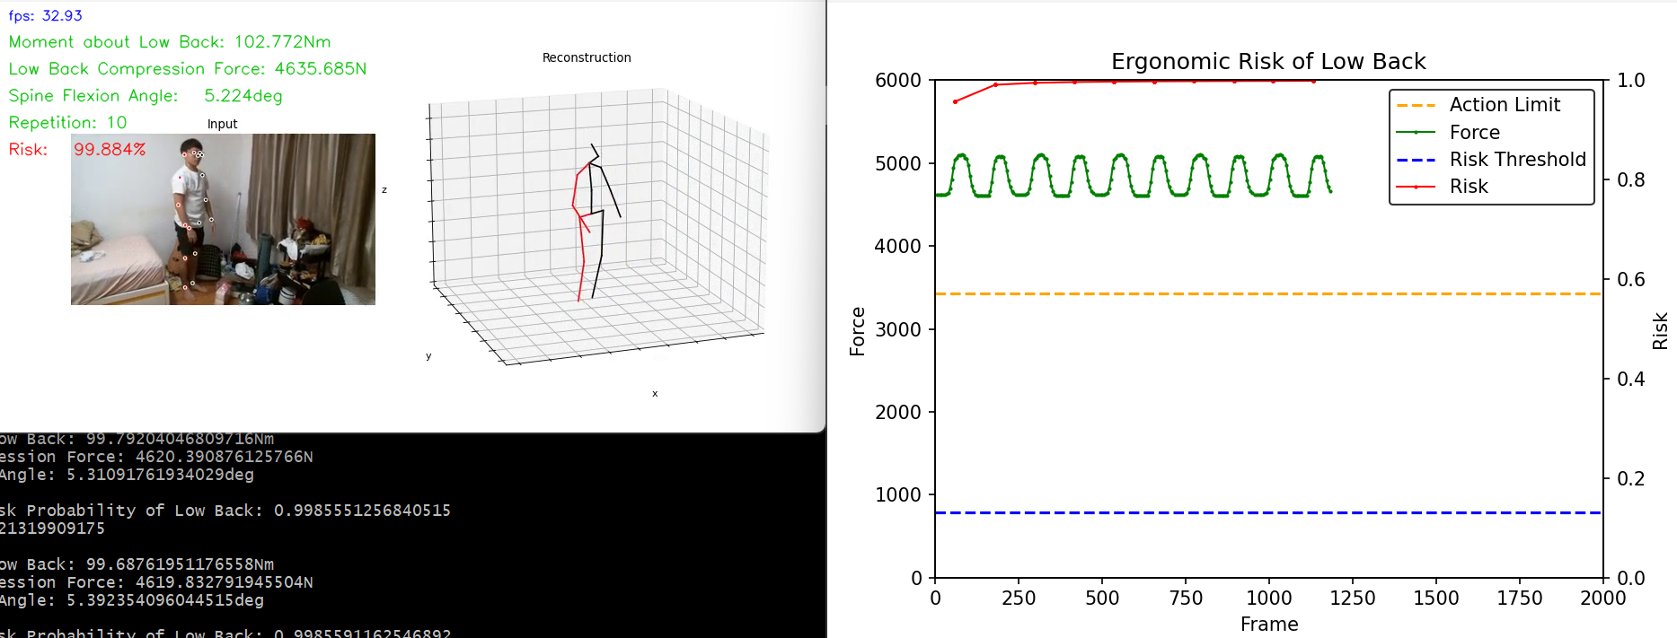
Body Weight: 600 N
Load: 230 N
a: 5

Slide 11
Conclusion
Compute low back compression force based only on image features
Apply monocular vision-based 3D pose estimation in ergonomic cumulative damage assessment

Slide 12
Subsequent Research’s Framing and Positioning

Slide 13
Next Meeting
Research Paper
Improve the validation, how can we use different experiment to validate our results. Check the comments for this.
How is our research unique? The conversion process technically can be automated.
Think of a research title, what questions are we going to answer.

